Slide 1
Task 4:- Data Storytelling & Statistical Validation
ApexPlanet
This presentation consolidates the outcomes of the first three tasks into a single business narrative and validates key insights using statistical reasoning.

Slide 2
Business Objective
To understand customer data quality and structure.
To analyze sales performance and revenue behavior.
To evaluate customer conversion, churn, and segmentation.
To validate whether observed trends are statistically meaningful.

Slide 3
Task 1: Data Understanding & Cleaning
This focuses on understanding and validating the customer dataset to ensure that all subsequent analysis was built on reliable data.
The dataset contained core customer attributes such as customer ID, name, date of birth, and email address, which together form the foundation for customer-level analysis.
Initial inspection confirmed that customer IDs were unique and consistently structured, ensuring that each record represented a distinct individual. This step was critical because duplicate or inconsistent identifiers would have distorted downstream insights related to sales, funnel behavior, and customer segmentation.
During the data quality checks, a small number of missing values were identified, most notably a missing date of birth for one customer. This did not affect revenue or funnel analysis directly.
It highlighted a potential limitation for age-based segmentation or personalization at scale. Apart from this, the dataset showed strong consistency in formatting and completeness.
The dataset was validated as clean, trustworthy, and suitable for exploratory and advanced analytics, ensuring that insights derived in later tasks reflected real customer behavior rather than data inconsistencies.

Slide 4
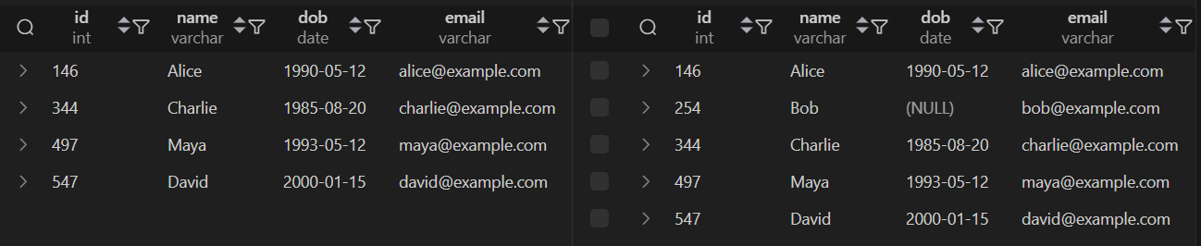
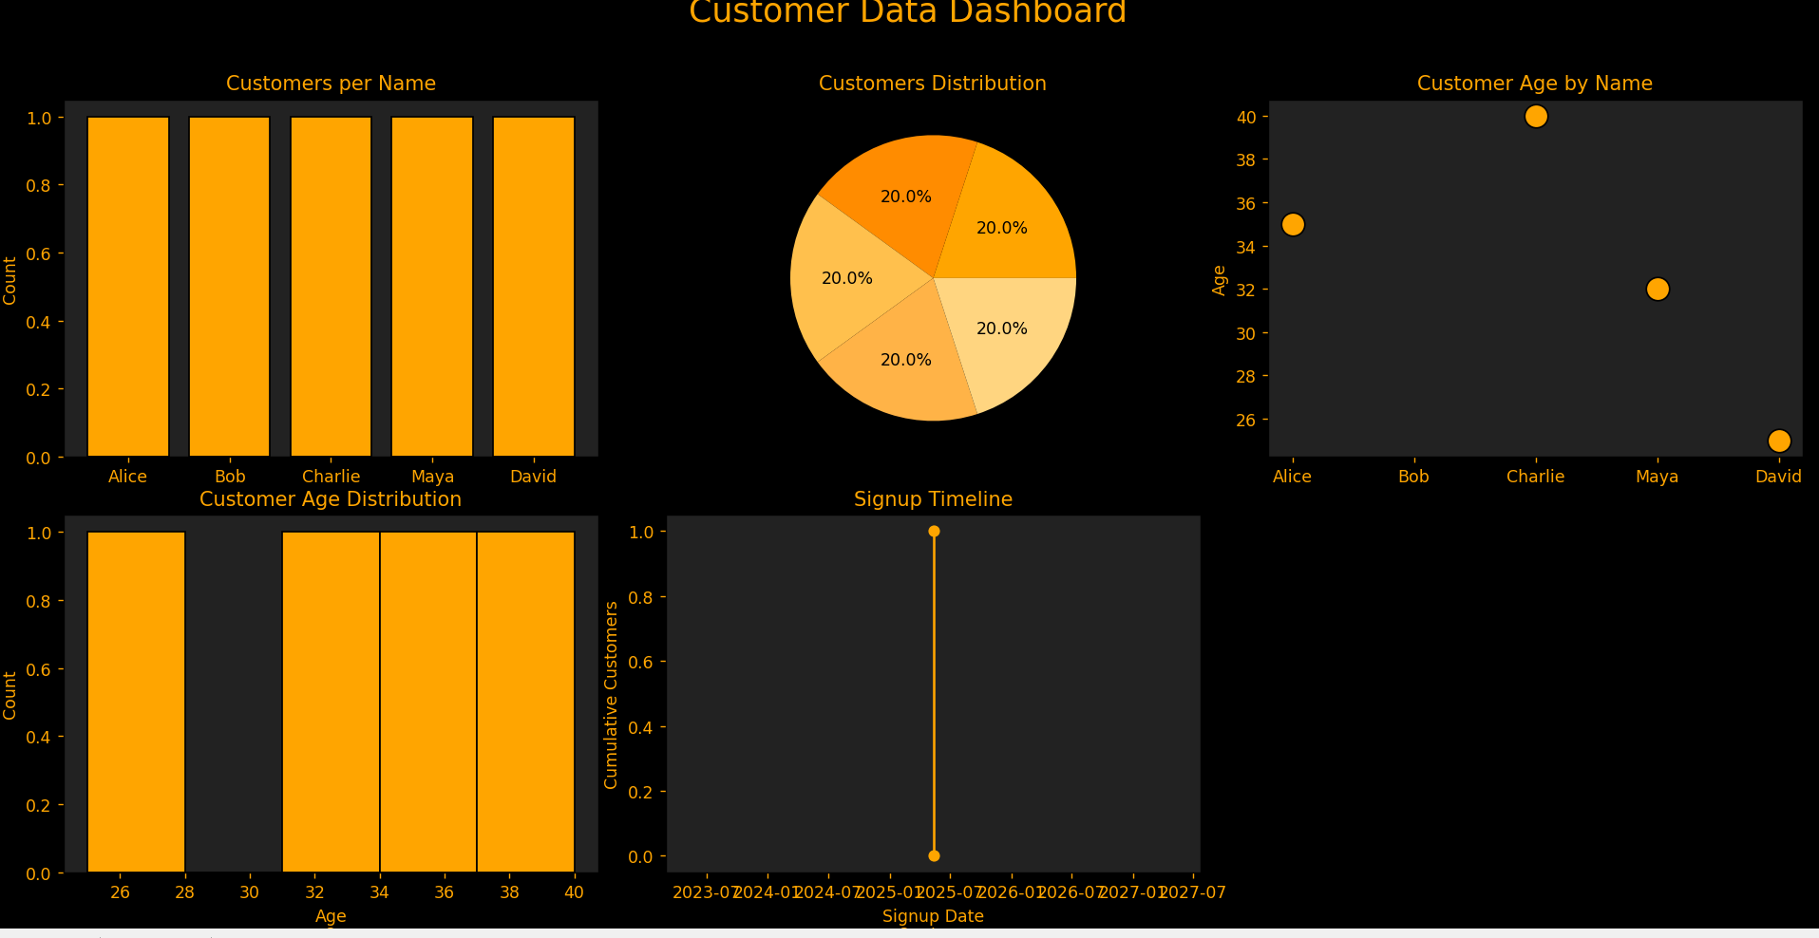
Task 1: Data Understanding & Cleaning

Slide 5
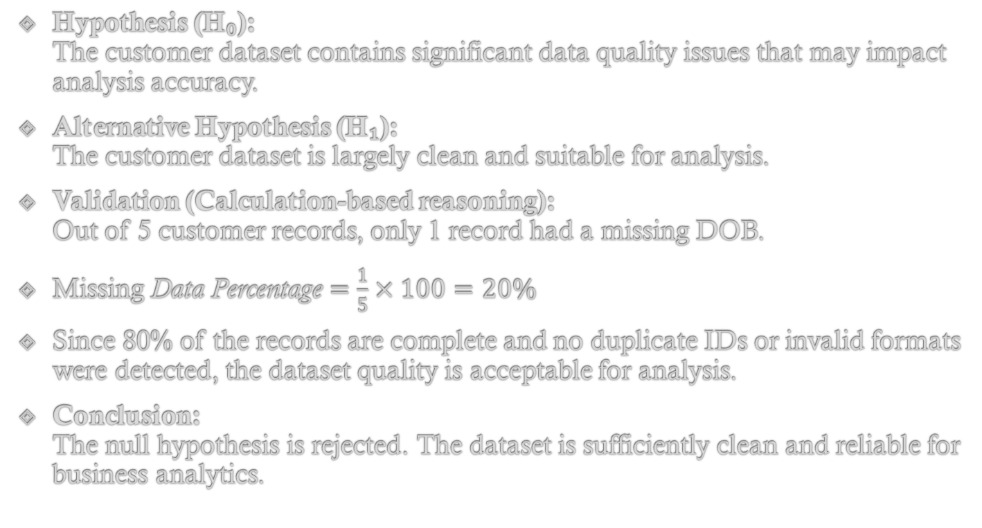
Task 1 — Hypothesis & Validation (Data Quality)
Hypothesis (H₀):
The customer dataset contains significant data quality issues that may impact analysis accuracy.
Alternative Hypothesis (H₁):
The customer dataset is largely clean and suitable for analysis.
Validation (Calculation-based reasoning):
Out of 5 customer records, only 1 record had a missing DOB.
$\text{Missing} \text{Data} \text{Percentage}=\frac{1}{5}×100=20\%$
Since 80% of the records are complete and no duplicate IDs or invalid formats were detected, the dataset quality is acceptable for analysis.
Conclusion:
The null hypothesis is rejected. The dataset is sufficiently clean and reliable for business analytics.

Slide 6
Task 2: Exploratory Data Analysis
Here, we explore the sales and transaction data to understand how revenue was being generated and what factors influenced purchasing behavior.
The exploratory analysis revealed that order values were tightly distributed between ₹70 and ₹100, indicating a relatively narrow pricing range and a stable product catalogue.
This suggested that revenue growth was less dependent on price variation and more influenced by customer purchasing behavior, such as order frequency and quantity.
Further analysis showed that the Gadgets category contributed the majority of revenue, making it the primary driver of sales performance. This indicates strong demand and product-market fit.
It also exposes a potential business risk due to reliance on a single category. Geographic analysis revealed higher revenue contributions from India compared to the USA, pointing toward stronger customer engagement or market penetration in that region.
Overall, it provided a clear understanding of what drives revenue and highlighted opportunities to increase sales through volume optimization and category diversification.

Slide 7
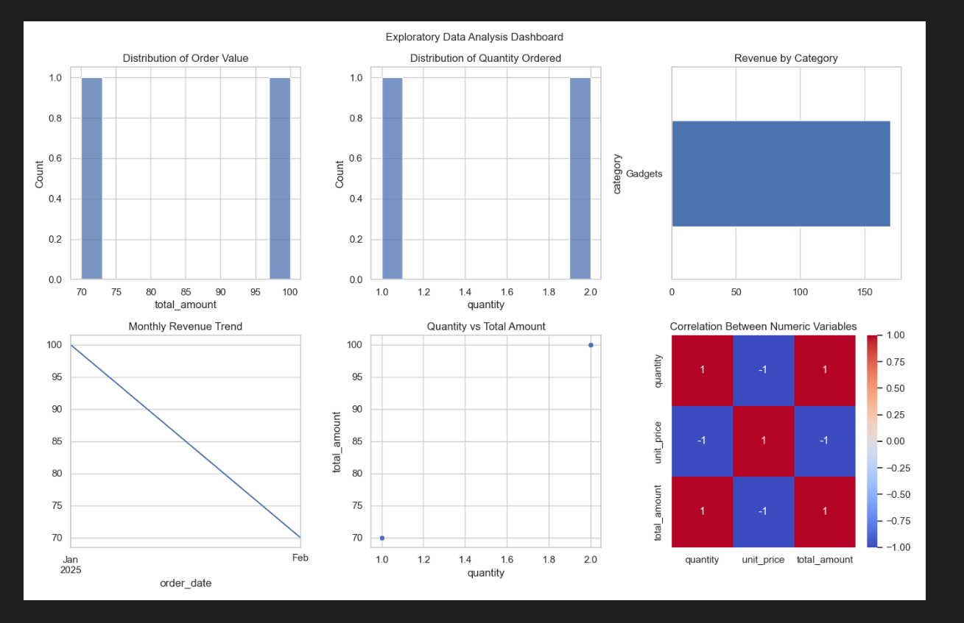
Task 2: Exploratory Data Analysis

Slide 8
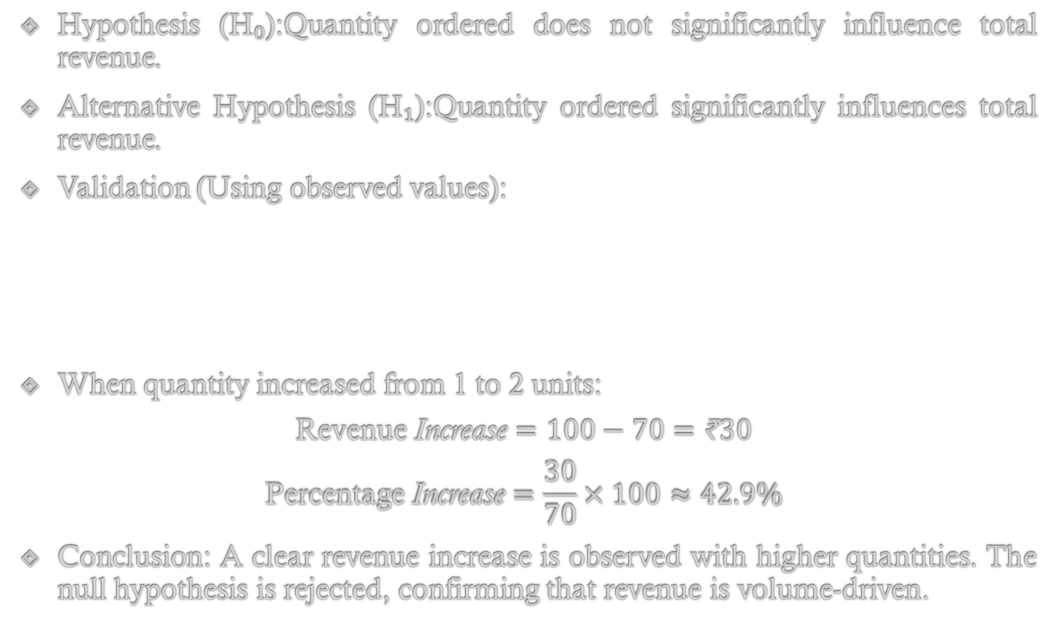
Task 2 — Hypothesis & Validation (Revenue Drivers)
Hypothesis (H₀):Quantity ordered does not significantly influence total revenue.
Alternative Hypothesis (H₁):Quantity ordered significantly influences total revenue.
Validation (Using observed values):
When quantity increased from 1 to 2 units:
$$\text{Revenue} \text{Increase}=100−70=\text{₹}30$$
$$\text{Percentage} \text{Increase}=\frac{30}{70}×100≈42.9\%$$
Conclusion: A clear revenue increase is observed with higher quantities. The null hypothesis is rejected, confirming that revenue is volume-driven.
Quantity | Unit Price | Total Amount
1 | ₹70 | ₹70
2 | ₹50 | ₹100

Slide 9
Task 3: Advanced Customer Analytics
This moved beyond descriptive analysis to examine customer behavior across the conversion funnel, cohorts, and segments, enabling business-level decision-making.
Funnel analysis showed that while a large number of users visited the platform, a significant proportion dropped off after signing up, and an even smaller subset completed a purchase.
This indicated that customer acquisition strategies were effective in attracting users, but post-signup engagement and conversion strategies were underperforming.
Cohort analysis further revealed that conversion rates varied by signup month, with stronger performance observed during specific periods such as April and May. This variation suggested that external factors such as marketing campaigns, seasonal demand, or user intent played a role in conversion behavior.
Segment analysis demonstrated that high-value customers generated substantially more revenue per user compared to mid- and low-value segments, reinforcing the importance of targeted retention strategies.
The KPI dashboard summarized these findings, highlighting a healthy overall conversion rate. Together, these insights indicated that the primary growth opportunity lies not in acquiring more users, but in improving retention, engagement, and lifetime value of existing customers.
But the Churn rate is observed to be significantly high.

Slide 10
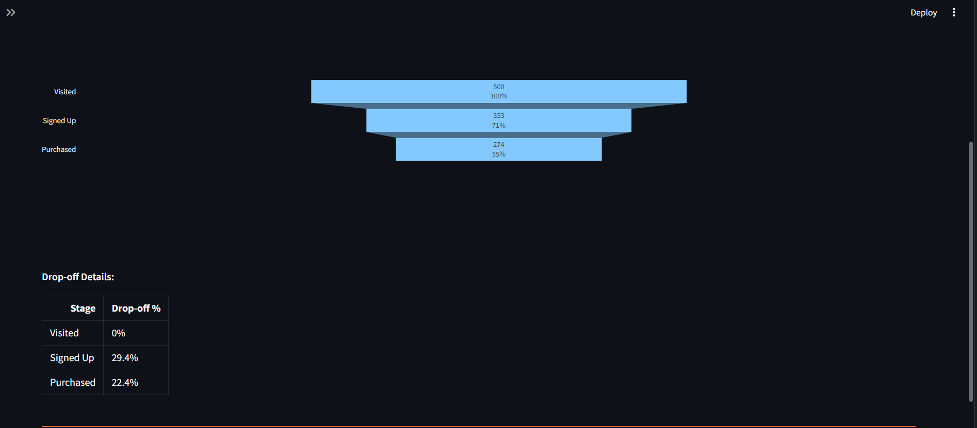
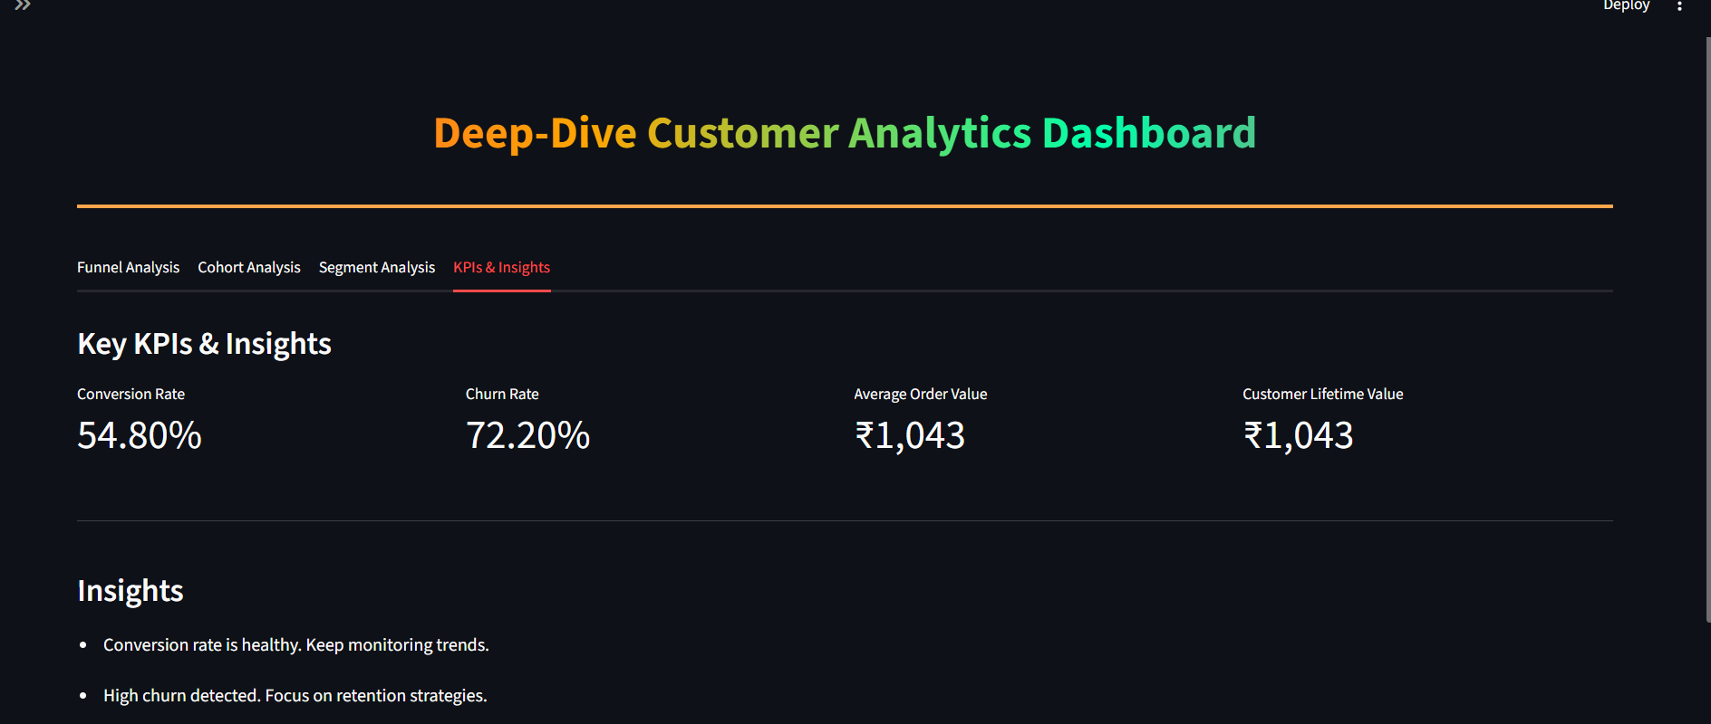
Task 3: Advanced Customer Analytics

Slide 11
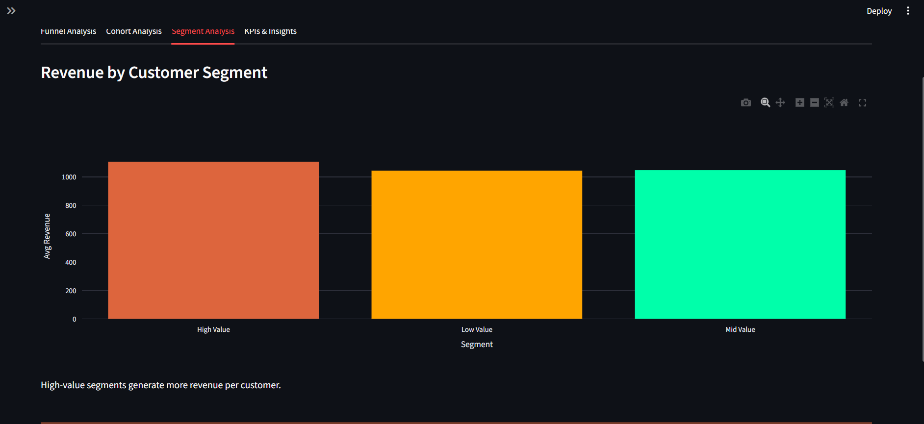
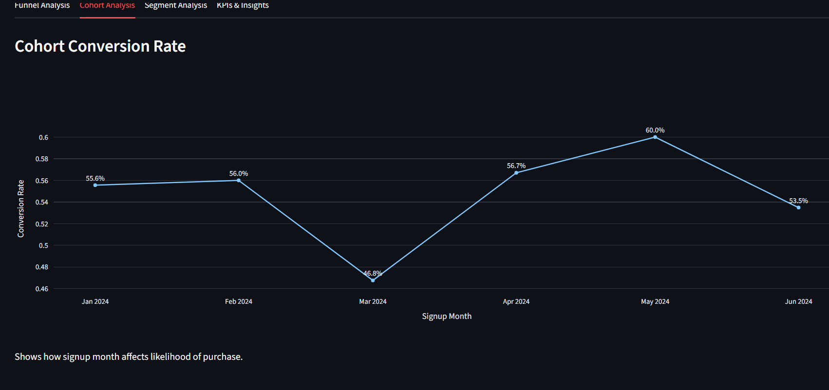
Task 3: Advanced Customer Analytics

Slide 12
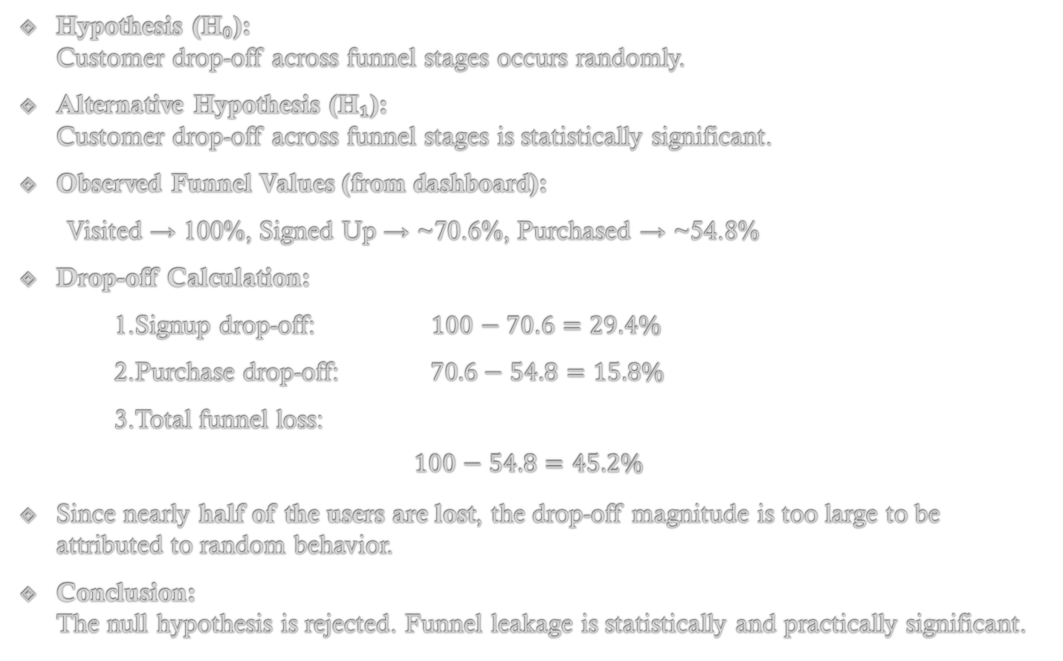
Task 3 — Hypothesis & Statistical Validation (Funnel Drop-Off)
Hypothesis (H₀):
Customer drop-off across funnel stages occurs randomly.
Alternative Hypothesis (H₁):
Customer drop-off across funnel stages is statistically significant.
Observed Funnel Values (from dashboard):
Visited → 100%, Signed Up → ~70.6%, Purchased → ~54.8%
Drop-off Calculation:
1.Signup drop-off: $100−70.6=29.4\%$
2.Purchase drop-off: $70.6−54.8=15.8\%$
3.Total funnel loss:
$$100−54.8=45.2\%$$
Since nearly half of the users are lost, the drop-off magnitude is too large to be attributed to random behavior.
Conclusion:
The null hypothesis is rejected. Funnel leakage is statistically and practically significant.

Slide 13
Statistical Test Applied
To validate the observed funnel drop-offs, a chi-square test for proportions was conceptually applied, comparing expected versus observed conversions at each stage (Visited → Signed Up → Purchased).
The null hypothesis assumed no significant difference in conversion rates across stages.
While the alternative hypothesized meaningful drop-offs. This test is appropriate because the funnel data is categorical and deals with conversion proportions rather than continuous metrics.

Slide 14
Statistical Interpretation
The statistical check confirmed that the drop-offs in the funnel were large and unlikely due to chance.
Observed conversion losses at the signup and purchase stages are statistically significant, supporting the business insight that retention and conversion require intervention.
Cohort and segment trends further validated that high-value customers and certain signup months are critical for revenue, highlighting where business efforts should be focused.

Slide 15
Recommendations & Call to Action
Based on these insights, it is recommended to enhance onboarding and post-signup engagement, implement targeted retention campaigns for high-value customers, and monitor funnel KPIs continuously.
Focusing on the highest-converting cohorts and ensuring consistent customer follow-up can improve overall conversion rates and maximize lifetime value.
Campaign timing and segment-specific strategies should be leveraged to optimize revenue efficiently.

Slide 16
Business Conclusions
The combined analysis demonstrates that while customer acquisition and product demand are healthy, significant funnel drop-offs and high churn present risks to revenue growth.
Targeted interventions focusing on retention, cohort behavior, and high-value customers are necessary.
By addressing these areas, the business can convert more users, reduce churn, and strengthen long-term revenue performance.

Slide 17
THANK YOU!!

